Slide 1

캡스톤 디자인 - Path Planning 13th Week Progress
A6 Blue
2022/11/22

Slide 2

Path Planning
Search-based
Dijkstra
A* - Dijkstra + heuristic cost
D* - Dynamic A*
Sampling-based
RRT – Random Tree
RRT* - RRT + rewire
Artificial Intelligence
ANN – Artificial Neural Network
GA – Genetic Algorithm

Slide 3
Our Algorithm
Design own algorithm
- A*(D*) 기반 : 장애물 회피
Using python & ROS
- Simulation
Using drone
- 3D path planning
- Safety distance
- Cost function optimization

Slide 4
A* Algorithm
Search-based algorithm
Dijkstra + heuristic cost
Cost function : f(n) = g(n) + h(n)
g(n) : 현재 node까지의 cost
h(n) : 현재 node부터 목표 node
까지의 heuristic cost

Slide 5
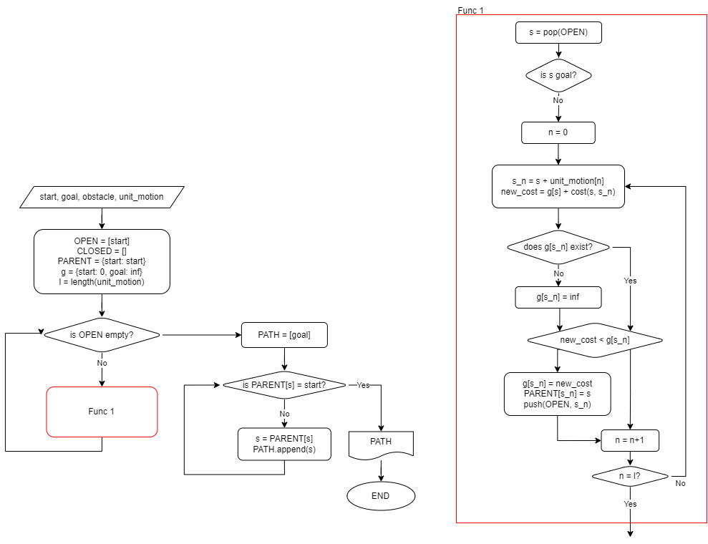
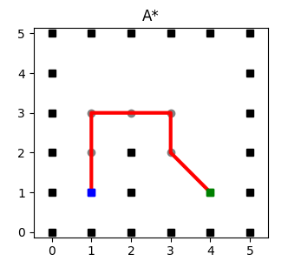
A* Algorithm
Flowchart

Slide 6
Schematic(updated)
Satellite
/pp/obs
Planning
Node
3 IOs / 3 Nodes / 6 Topics
IOs:
Satellite: Detect and manage obstacles
User: Set destination point
Nodes:
Planning Node: Make map with obstacle. Path planning with current position, destination and map
Control Node: Transfer control signals and arrived trigger
User
/pp/destination
/pp/checkpoint
/pp/cp_arr
Control
Node
/mavros/setpoint_velocity/cmd_vel
/mavros/local/pose
Drone
MAVROS
(MAVLink)

Slide 7
Schematic(updated)
Satellite
/pp/obs
Planning
Node
Topics:
/pp/obs: contains array of xyz coordinates of obstacle
/pp/destination: contains xyz coordinates of destination
/pp/checkpoint: contains xyz coordinates of checkpoint, way to destination
/mavros/setpoint_velocity/cmd_vel: contains xyz velocity signal to checkpoint
/pp/cp_arr: contains bool if drone arrived checkpoint
/mavros/local/pose: contains xyz coordinates of drone's local position
User
/pp/destination
/pp/checkpoint
/pp/cp_arr
Control
Node
/mavros/setpoint_velocity/cmd_vel
/mavros/local/pose
Drone
MAVROS
(MAVLink)

Slide 8
Mapping(last week)
Plan for next week:
Make view-point in gazebo more comfortable
Apply created code to map that we make

Slide 9
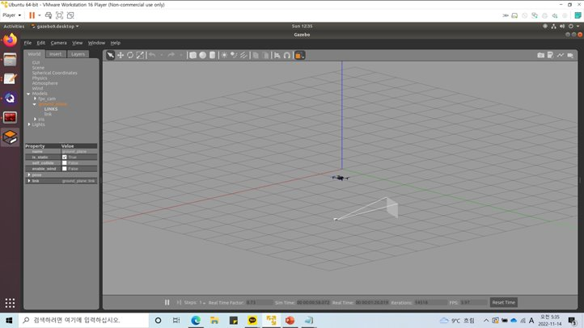
Mapping(problem)
Make view-point in gazebo more comfortable

Slide 10
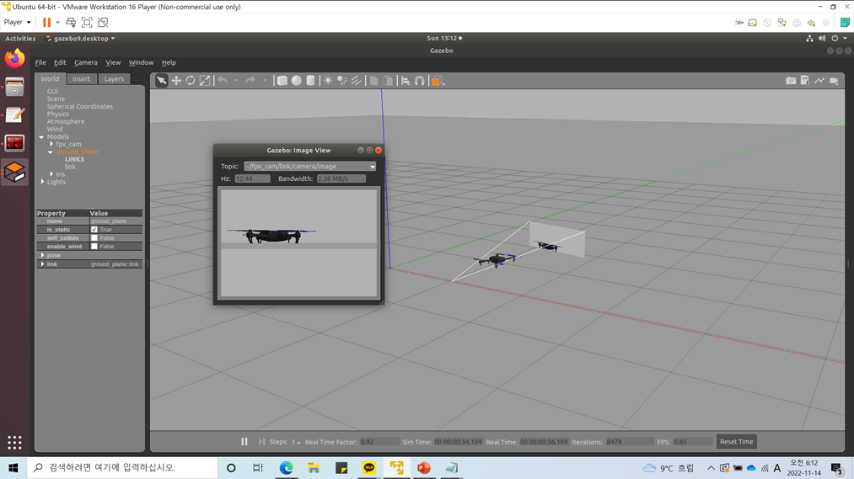
Mapping(problem)
Make view-point in gazebo more comfortable

Slide 11
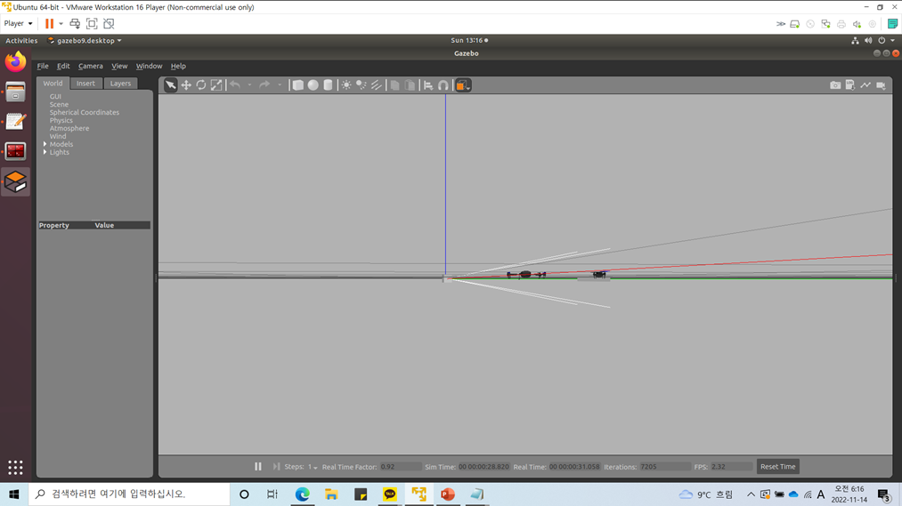
Mapping(problem)
Make view-point in gazebo more comfortable

Slide 12
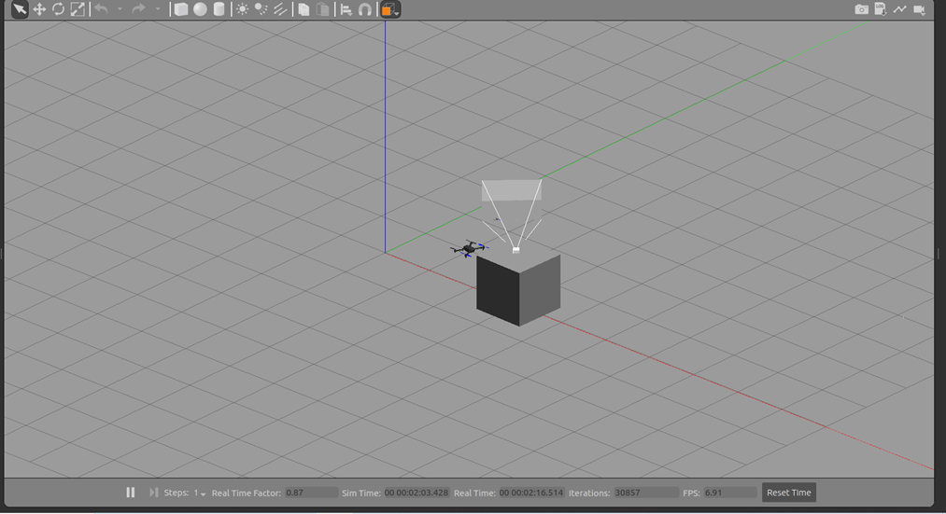
Mapping(problem)
Make view-point in gazebo more comfortable

Slide 13
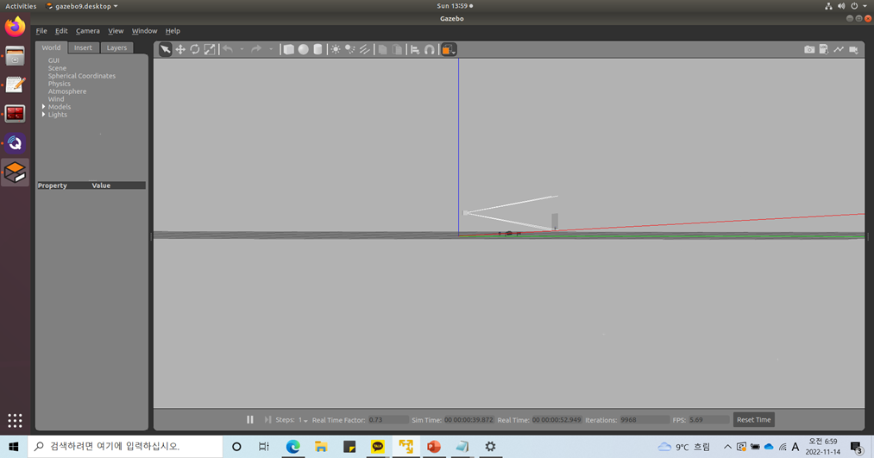
Mapping(problem)
Make view-point in gazebo more comfortable

Slide 14
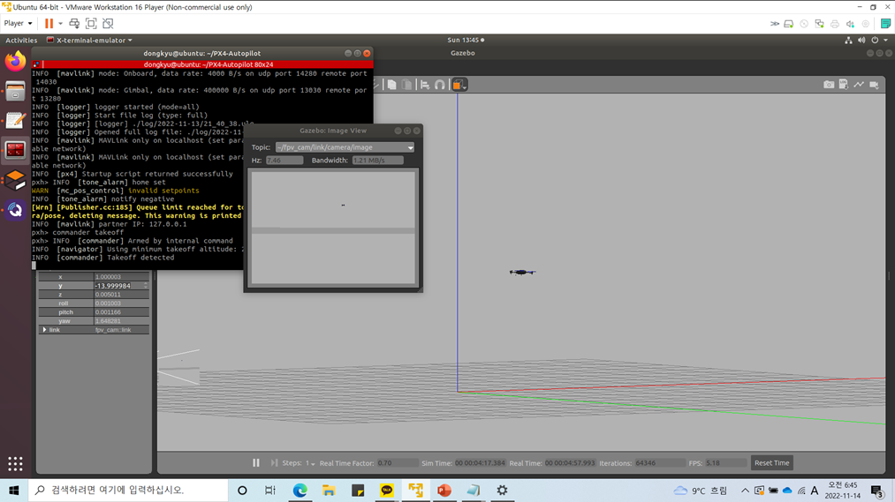
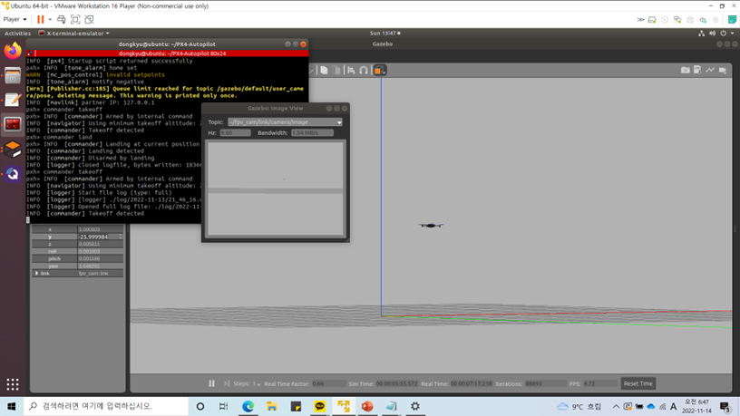
Mapping(problem)
Make view-point in gazebo more comfortable
Recommend : 14m
Max : 26m

Slide 15
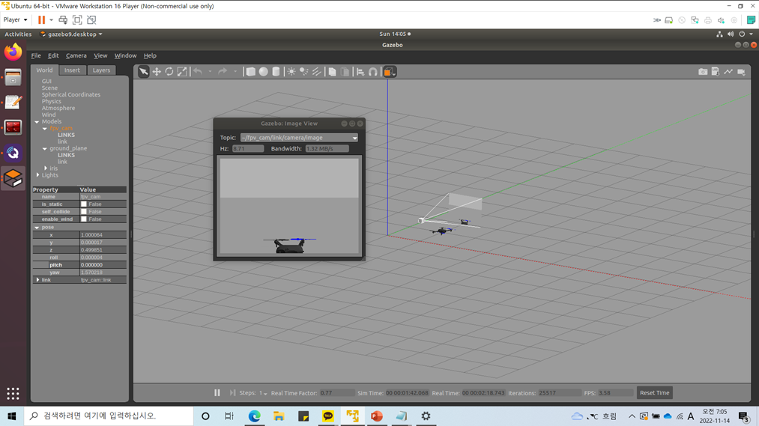
Mapping(problem)
Make view-point in gazebo more comfortable

Slide 16
Mapping(problem)
Apply created code
https://youtu.be/x96TDw0JUhw

Slide 17
Mapping(summary)
Achievements:
Apply created code
Control perspective
Real-time dynamic mapping with topic
Plan for next week:
solves the problem that occurred in executing the code

Slide 18
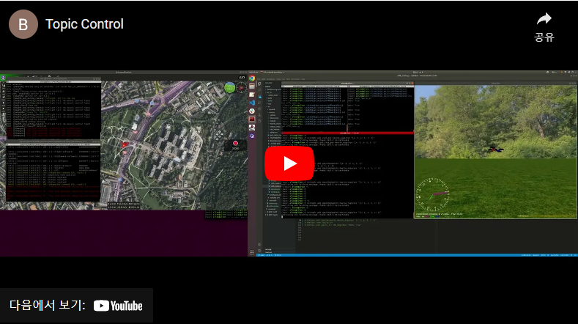
Control
Achievements:
PD control implemented:
- input : checkpoint, local position
- output : arrived signal, velocity
ROS embedded:
- Works with ROS embedded planning node
- input : /mavros/local/pose, /pp/checkpoint
- output : /mavros/setpoint_velocity/cmd_vel, /pp/cp_arr
Drone controllable via planning node
Sends /pp/cp_arr
- True if distance between checkpoint and current position is under particular distance
Prevent overshooting
- PD-control with x, y velocity

Slide 19
Control(Overshooting)
Solutions:
Step position input(default)
Sigmoid position input
Velocity control, P-control
Velocity control, PD-control
Keypoints:
Faster response
Reduce overshoot (≈0%)
Reduce stuttering
Minimize acceleration

Slide 20
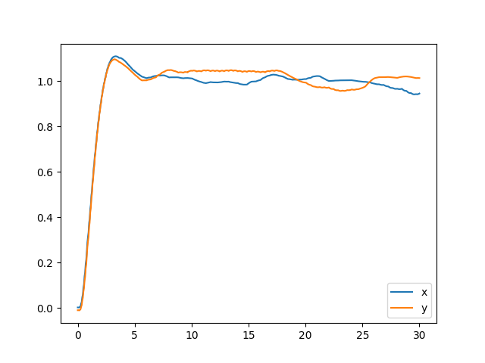
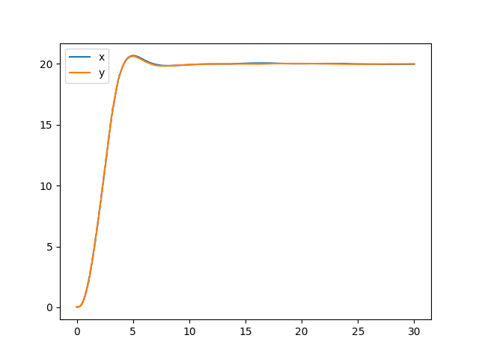
Control(Overshooting – default step position input)
Step position input(default)
About 15% overshoot occurs in unit step input.
About 10% overshoot occurs in 20 step input.
Settling time: about 7s
Step input, x, y=1
Step input, x, y=20

Slide 21
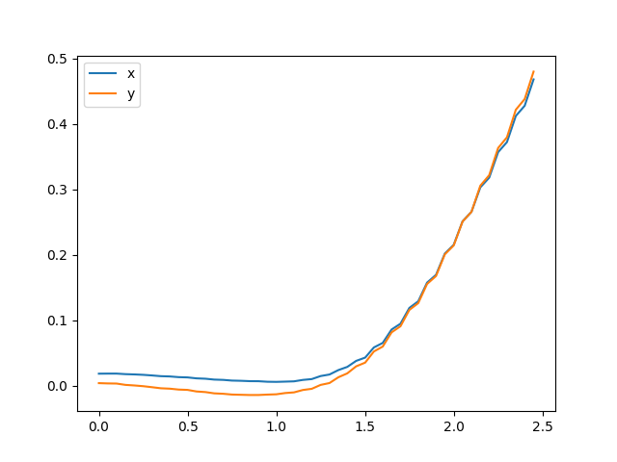
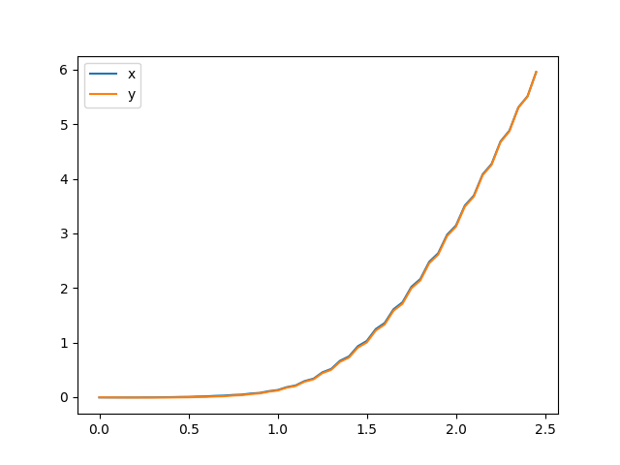
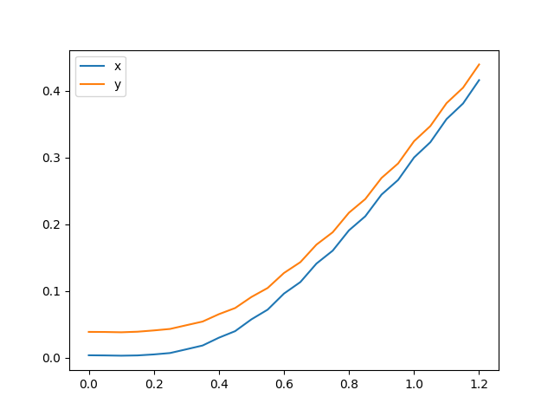
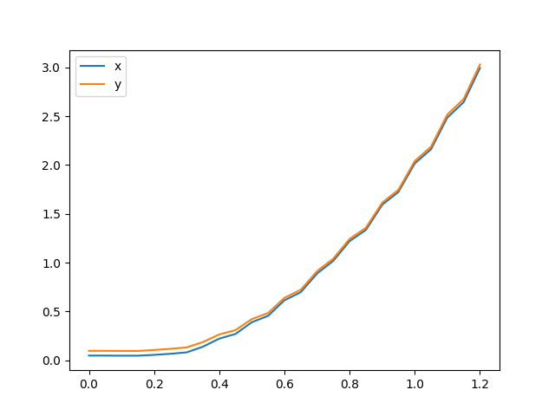
Control(Overshooting – sigmoid position input)
Sigmoid position input(logistic function)
Response time with logistic position input is too long

Slide 22
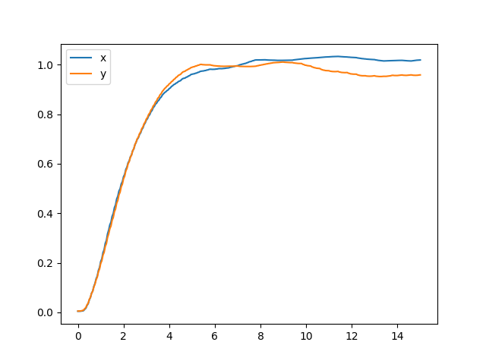
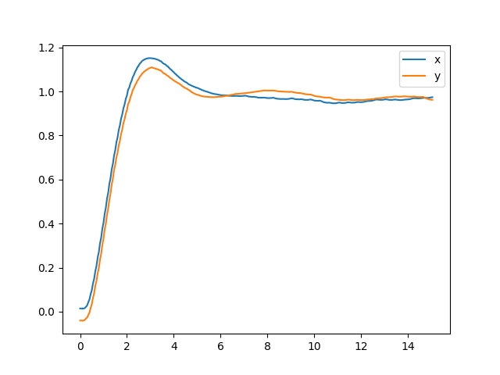
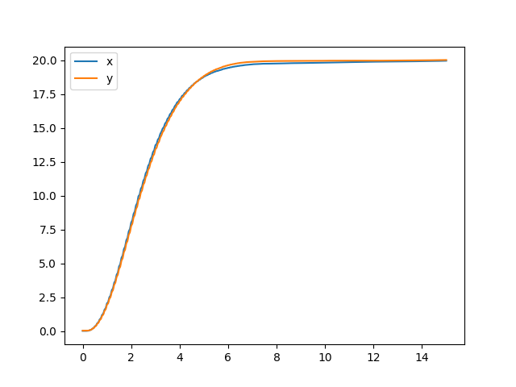
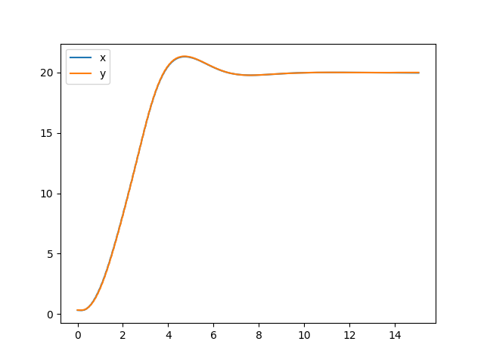
Control(Overshooting – P-controlled velocity)
Velocity control, P-control
No overshoot occurs with p=0.5
About 15% overshoot occurs with p=1
Settling time = 5~6s on both p=0.5 and p=1
P=0.5, x, y=1
P=1, x, y=1
P=0.5, x, y=20
P=1, x, y=20

Slide 23
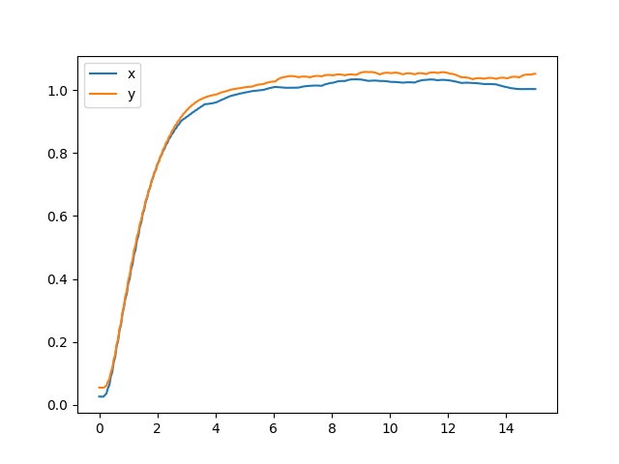
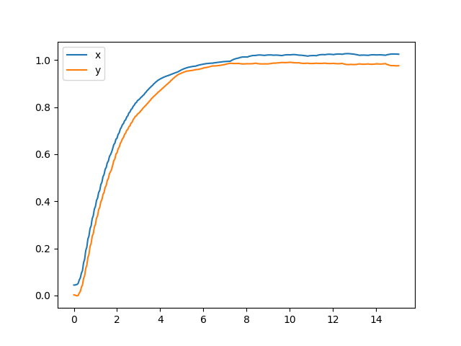
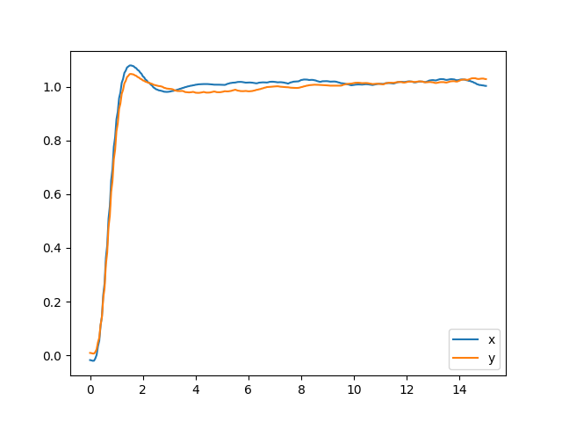
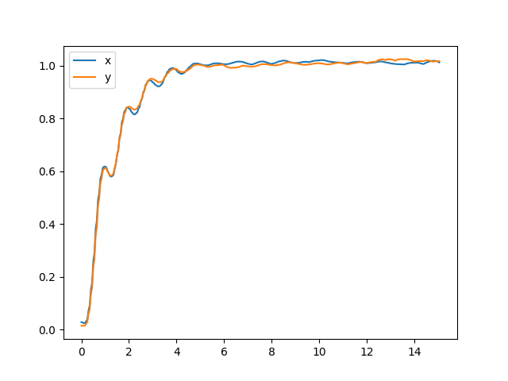
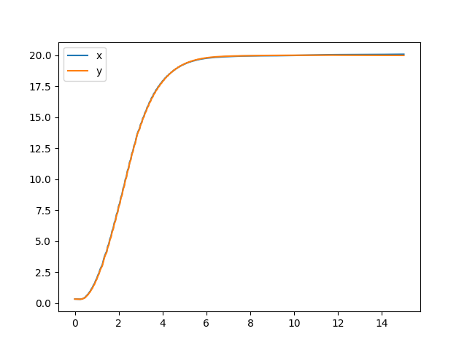
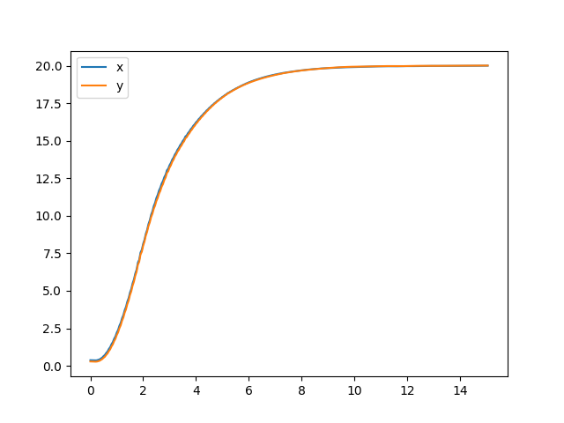
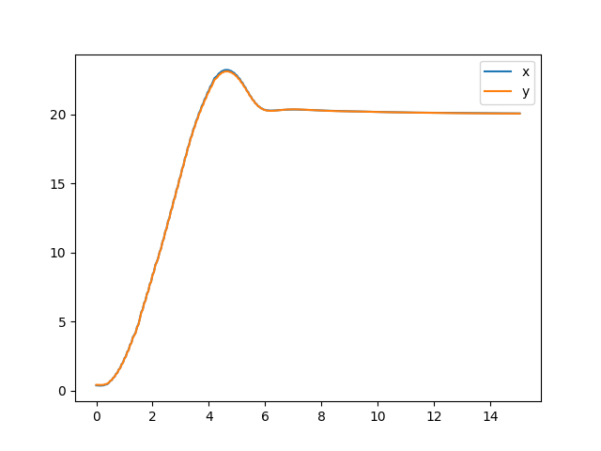
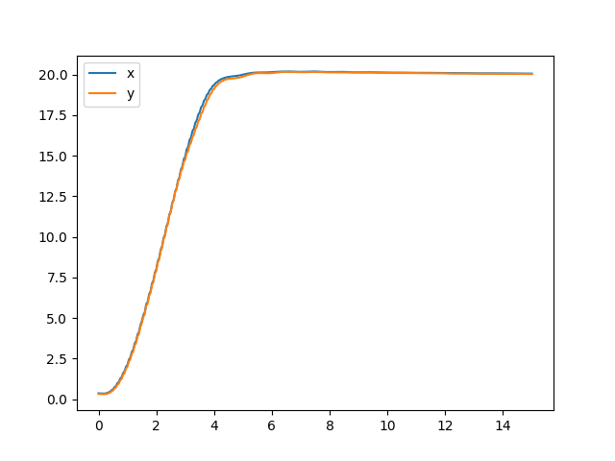
Control(Overshooting – PD-controlled velocity)
Velocity control, PD-control
P=1, D=200, (1)
P=1, D=400, (1)
P=3, D=400, (1)
P=3, D=1000, (1)
P=1, D=200, (20)
P=1, D=400, (20)
P=3, D=400, (20)
P=3, D=1000, (20)

Slide 24
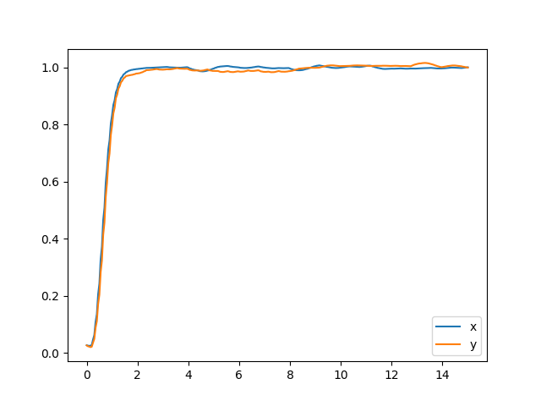
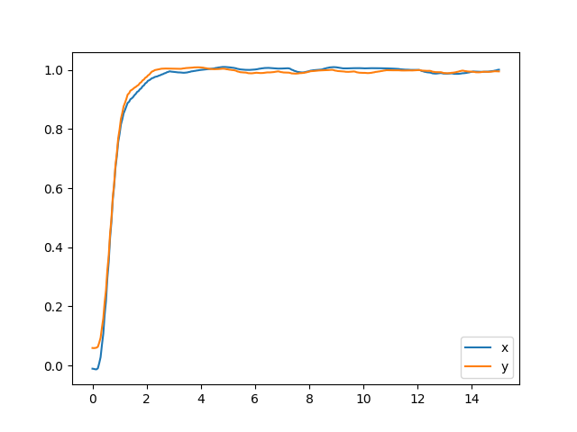
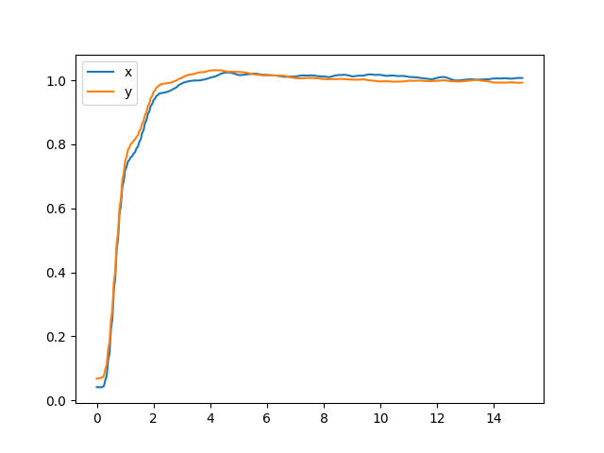
Control(Overshooting – PD-controlled velocity)
Velocity control, PD-control
No overshoot occurs with p=1
Faster settling time and response time with p=3
Stuttering occurs with large d(=1000) for small distance
=> p=3, d=1000 shows best performance for large distance
-> find optimal d parameters with p=3 for small distance
=> p=3, d=500 shows best performance for large distance
P=3, D=400, (1)
P=3, D=500, (1)
P=3, D=600, (1)
P=3, D=700, (1)

Slide 25
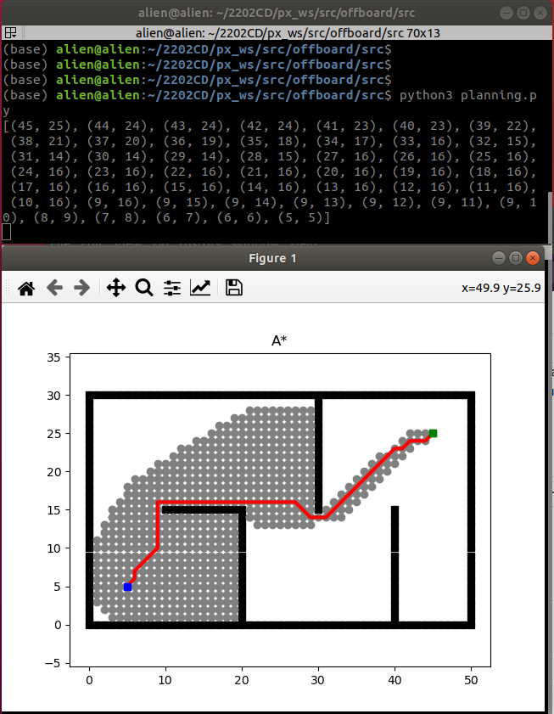
Planning
Achievements:
A* algorithm implemented
- input : map, start, destination
- output : route to destination
ROS embedded
- input : /pp/map, /pp/destination, /pp/cp_arr, /pp/obs
- output : /pp/checkpoint
Dynamic mapping(continuous A*)
- Update map with A* when obstacle detected
Path simplification
- Planning node simplifies the path along same direction
Plan for next week:
Improve dynamic mapping(A* or D*)

Slide 26
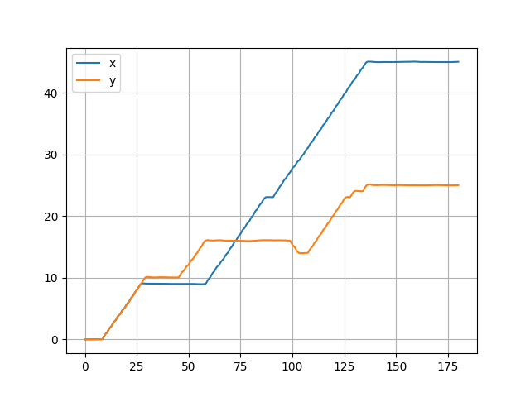
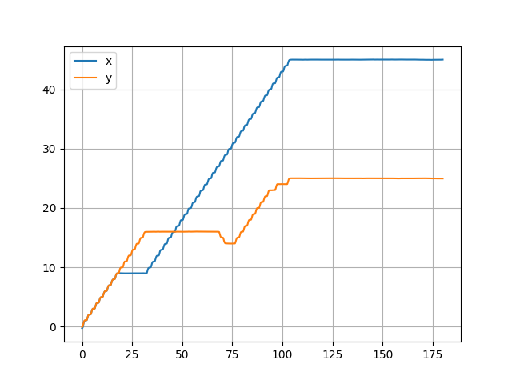
Planning(Path simplification)
Why is path simplification required?
To prevent overshoot and to improve response time, PD-control applied.
But path with unit length(1 or 1.41) made drone continuously stops on each checkpoints.
-> Response time shortened with PD-control: 130s -> 110s
--> Apply path simplification: Planning node simplifies the path along same direction
Step input(default)
PD-control

Slide 27
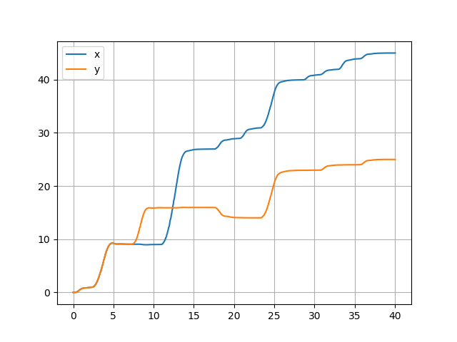
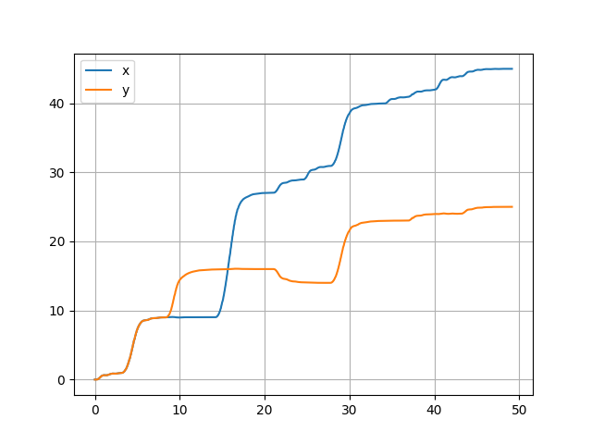
Planning(Path simplification)
Path simplification made checkpoints with large distance; PD parameters had to changed
P=3, D=700 / P=3, D=1000 showed best performances.
=> Response time shortened with simplification: 110s->37s, 45s
=> No stop-and-go occurred.
P=3, D=700(simple)
P=3, D=1000(simple)
(video)
(video)

